Slide 1

Project 2
By
Jacob Nesteruck, ,Ray Jaconski, Raymond Fillingame
Keyon Hawkins, Martin Salinas

Slide 2
Task
Generate a randomized dataset based on the given E-Commerce data structure
Analise a large dataset of 10-15 thousand records using an E-Commerce data structure.

Slide 4
What is the top selling category of items? Per country?

Slide 5
How does the popularity of products change throughout the year? Per country?

Slide 6
Locations that see the highest traffic of sales.
Country | Total Sales | Percentage
India | 4243 | 6.90%
Ireland | 4228 | 6.88%
Great Britain | 4222 | 6.87%
Korea | 4213 | 6.85%
United States | 4192 | 6.82%

Slide 7
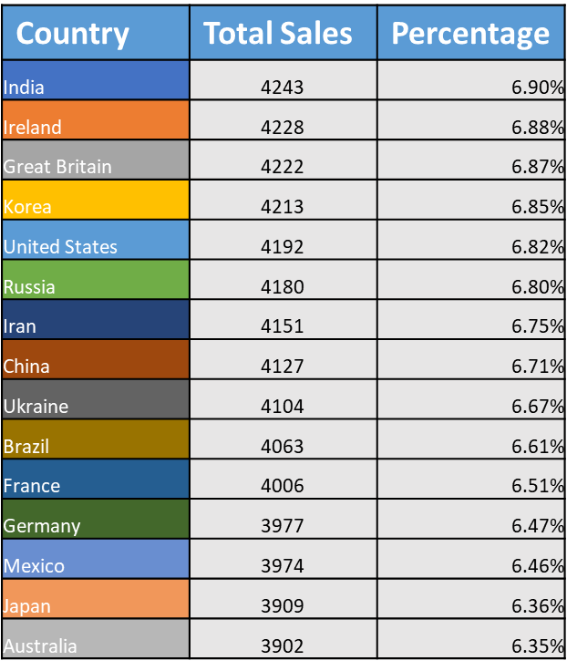
Total sales by country

Slide 8
What times have the highest traffic of sales? Per country?

